Slide 1

Foundations of Cryptography security parameter, PPT, negligible, IND-EAV, $$PrivK_{𝒜, Π}^{eav}\left(n\right), PrivK_{𝒜, Π}^{eav}\left(n,b\right)$$
LiangFeng Zhang
zhanglf@shanghaitech.edu.cn
SIST, ShanghaiTech, 2019F

Slide 2
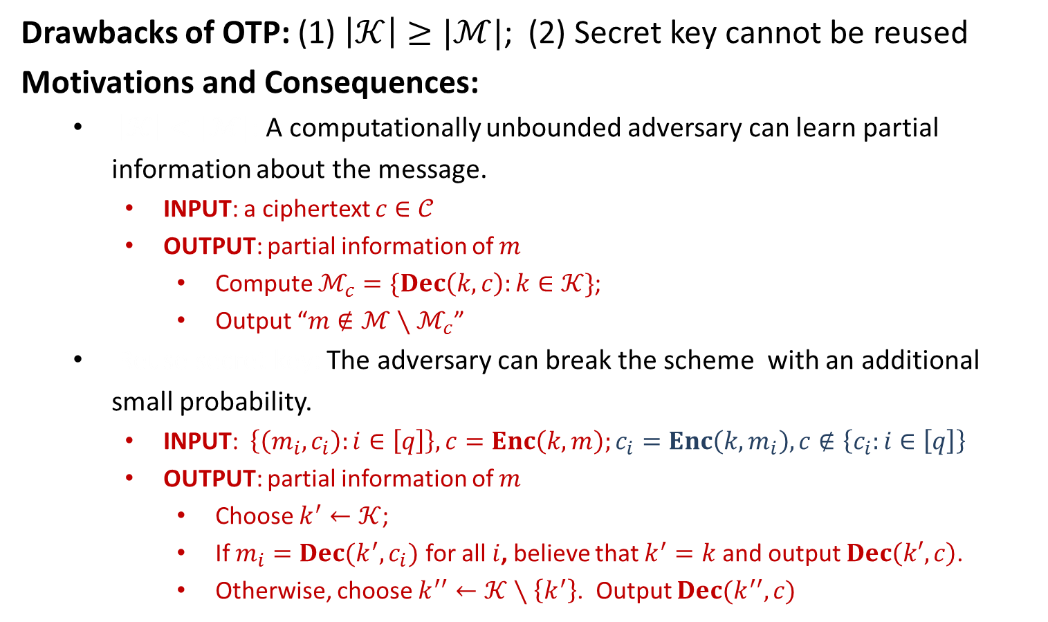


Computational Security
Drawbacks of OTP: (1) $\left|𝒦\right|≥|ℳ|$; (2) Secret key cannot be reused
Motivations and Consequences:
$\left|𝒦\right|<|ℳ|$: A computationally unbounded adversary can learn partial information about the message.
INPUT: a ciphertext $c∈𝒞$
OUTPUT: partial information of $m$
Compute $ℳ_{c}=\{Dec\left(k,c\right):k∈𝒦\}$;
Output “$m∉ℳ∖ℳ_{c}$”
Reuse secret key: The adversary can break the scheme with an additional small probability.
INPUT: $\left\{\left(m_{i},c_{i}\right):i∈\left[q\right]\right\}, c=Enc\left(k,m\right);c_{i}=Enc\left(k,m_{i}\right), c∉\left\{c_{i}:i∈\left[q\right]\right\}$
OUTPUT: partial information of $m$
Choose $k^{′}←𝒦$;
If $m_{i}=Dec(k^{′},c_{i})$ for all $i$, believe that $k^{′}=k$ and output $Dec\left(k′,c\right)$.
Otherwise, choose $k^{′′}←𝒦∖\left\{k^{′}\right\}$. Output $Dec(k^{′′},c)$
$$\left|𝒦\right|<\left|ℳ\right|:$$
brute-force
$$\text{Reuse} \text{secret} \text{key}\text{:}$$
random guess

Slide 3
Computational Security
Compromise: what we have to allow for a practical PrivKE scheme
The adversary’s computational power should be bounded.
Principle of Computational Security (Kerckhoffs): A cipher must be practically, if not mathematically, indecipherable
The adversary is allowed to succeed with an additional small probability.
As long as the probability is small enough, the adversary will not succeed, except it tries for an infeasible number of times.
Computational Security: A private-key encryption is secure if
The adversary is computationally bounded (efficient) and runs for some feasible amount of time; and
The adversary can potentially succeed with very small probability
How to Define Computational Security?
Concrete Approach; Asymptotic Approach

Slide 4
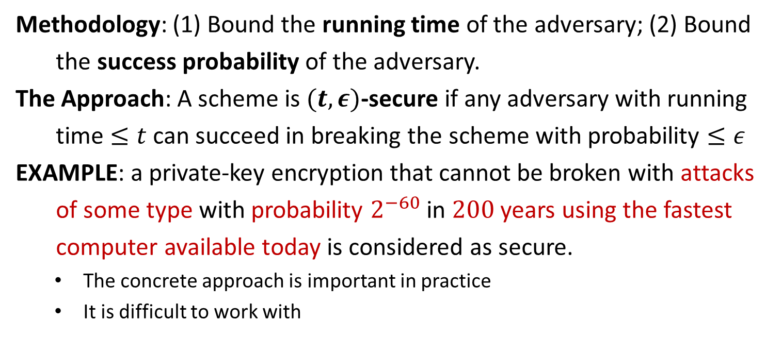
Concrete Approach
Methodology: (1) Bound the running time of the adversary; (2) Bound
the success probability of the adversary.
The Approach: A scheme is $(t,ε)$-secure if any adversary with running
time $≤t$ can succeed in breaking the scheme with probability $≤ε$
EXAMPLE: a private-key encryption that cannot be broken with attacks
of some type with probability $2^{−60}$ in $200$ years using the fastest
computer available today is considered as secure.
The concrete approach is important in practice
It is difficult to work with

Slide 5
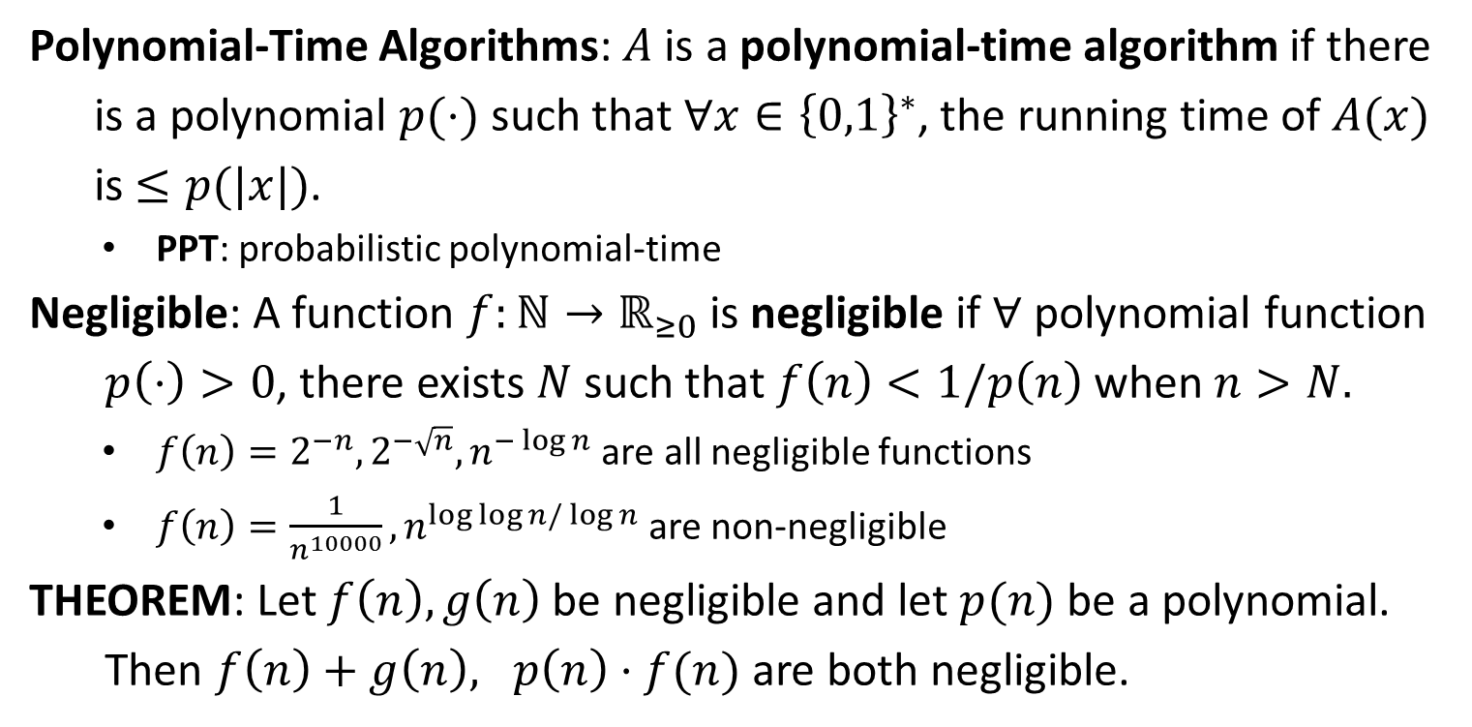
PPT and Negligible
Polynomial-Time Algorithms: $A$ is a polynomial-time algorithm if there
is a polynomial $p(⋅)$ such that $∀x∈{\left\{0,1\right\}}^{∗}$, the running time of $A(x)$
is $≤p(|x|)$.
PPT: probabilistic polynomial-time
Negligible: A function $f:ℕ→ℝ_{≥0}$ is negligible if $∀$ polynomial function
$p\left(⋅\right)>0$, there exists $N$ such that $f\left(n\right)<1/p\left(n\right)$ when $n>N.$
$f\left(n\right)=2^{−n}, 2^{−\sqrt{n}}, n^{−\log{n}}$ are all negligible functions
$f\left(n\right)=\frac{1}{n^{10000}}, n^{\log{\log{n}/\log{n}}}$are non-negligible
THEOREM: Let $f\left(n\right), g\left(n\right)$ be negligible and let $p(n)$ be a polynomial.
Then $f\left(n\right)+g\left(n\right), p\left(n\right)⋅f(n)$ are both negligible.

Slide 6
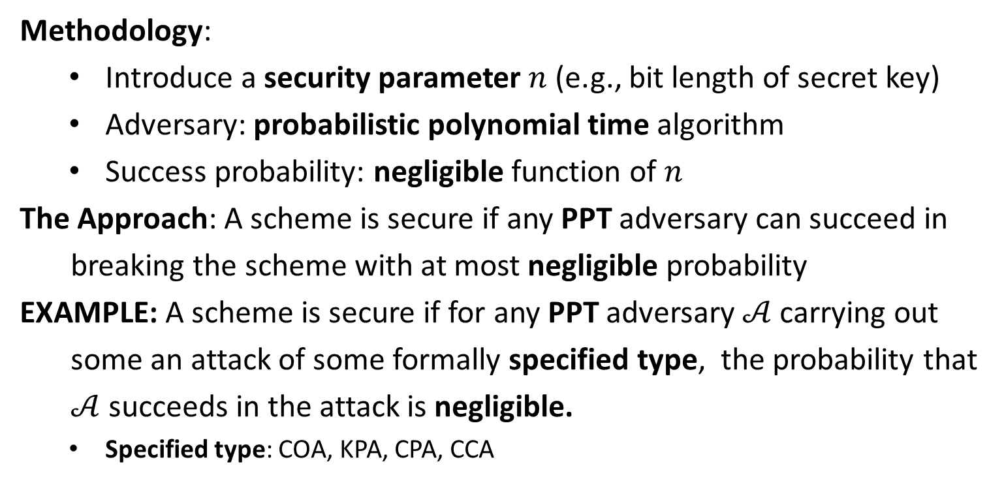
Asymptotic Approach
Methodology:
Introduce a security parameter $n$ (e.g., bit length of secret key)
Adversary: probabilistic polynomial time algorithm
Success probability: negligible function of $n$
The Approach: A scheme is secure if any PPT adversary can succeed in
breaking the scheme with at most negligible probability
EXAMPLE: A scheme is secure if for any PPT adversary $𝒜$ carrying out
some an attack of some formally specified type, the probability that
$𝒜$ succeeds in the attack is negligible.
Specified type: COA, KPA, CPA, CCA

Slide 8







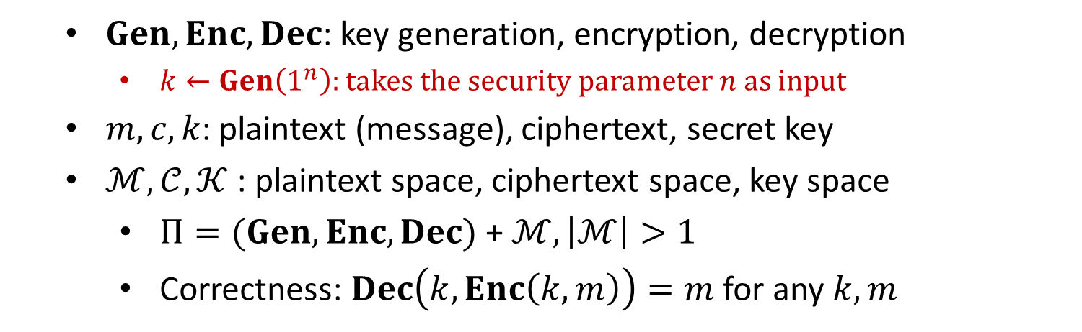



Private-Key Encryption
$$m$$
$$Enc$$
$$c←Enc(k, m)$$
$$Dec$$
Alice
Bob
$$k$$
$$k$$
$$Dec(k, c)=m$$
$$Gen$$
$Gen, Enc, Dec$: key generation, encryption, decryption
$k←Gen\left(1^{n}\right):$ takes the security parameter $n$ as input
$m, c, k$: plaintext (message), ciphertext, secret key
$ℳ,𝒞, 𝒦$ : plaintext space, ciphertext space, key space
$Π=(Gen, Enc, Dec)$ + $ℳ, \left|ℳ\right|>1$
Correctness: $Dec\left(k,Enc\left(k,m\right)\right)=m$ for any $k,m$

Slide 9
IND-EAV
Threat Model: the power of adversaries
computational power: probabilistic polynomial-time algorithms
actions: choose two plaintexts and observe one ciphertext
Security Guarantee: what is a break
Given the ciphertext, the adversary should be unable to learn any partial information of the plaintext
called semantic security (Goldwasser and Micali, 1985)
equivalent definition: indistinguishability (proved, ref. Goldreich)

Slide 10




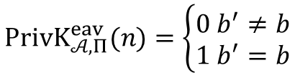


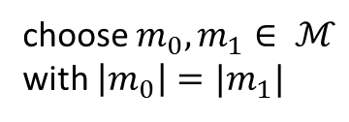

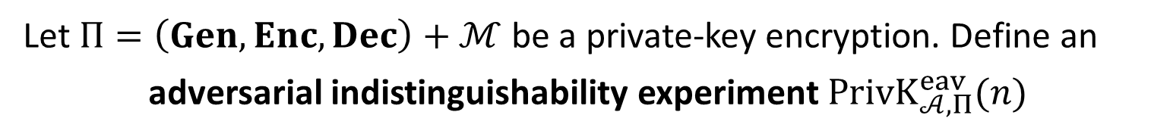


$$PrivK_{𝒜, Π}^{eav}(n)$$
Let $Π=\left(Gen, Enc, Dec\right)+ℳ$ be a private-key encryption. Define an
adversarial indistinguishability experiment $PrivK_{𝒜, Π}^{eav}(n)$
choose $m_{0}, m_{1}∈ ℳ$
with $\left|m_{0}\right|=|m_{1}|$
$$m_{0},m_{1}$$
$$k←Gen\left(1^{n}\right)$$
$$b←\{0,1\}$$
$$Challenger$$
$$c←Enc(k,m_{b})$$
$$Adversary 𝒜$$
$$c$$
$$b′$$
$$PrivK_{𝒜, Π}^{eav}(n)=\left\{\begin{aligned}0 b^{′}≠b \\ 1 b^{′}=b\end{aligned}\right.$$

Slide 11
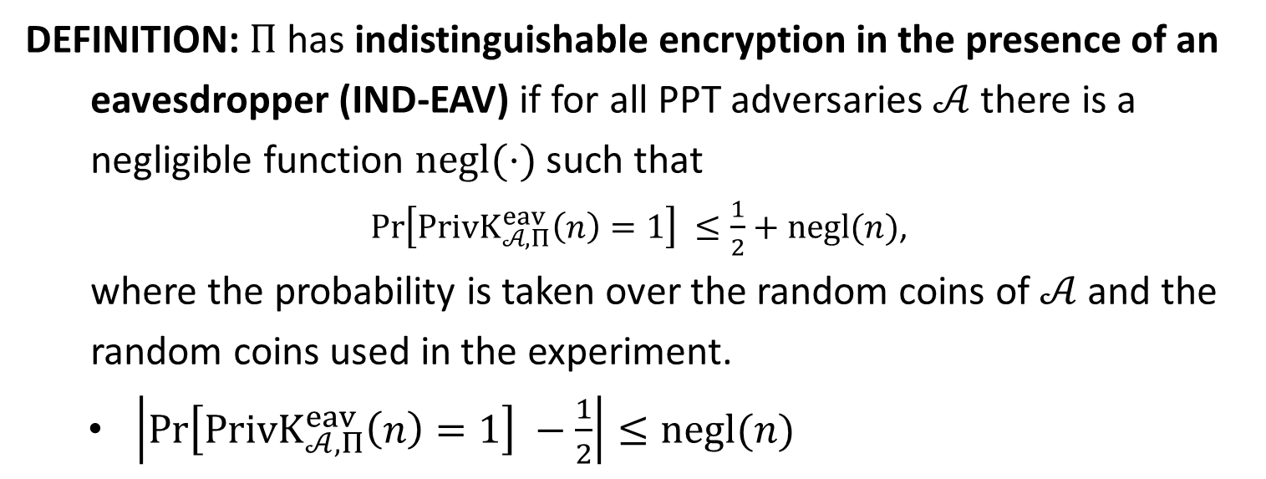
IND-EAV
DEFINITION: $Π$has indistinguishable encryption in the presence of an
eavesdropper (IND-EAV) if for all PPT adversaries $𝒜$ there is a
negligible function $negl(⋅)$ such that
$\operatorname{Pr}\left[PrivK_{𝒜, Π}^{eav}\left(n\right)=1\right] ≤\frac{1}{2}+negl(n)$,
where the probability is taken over the random coins of $𝒜$ and the
random coins used in the experiment.
$\left|\operatorname{Pr}\left[PrivK_{𝒜, Π}^{eav}\left(n\right)=1\right] −\frac{1}{2}\right|≤negl(n)$

Slide 12

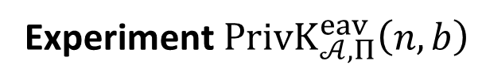





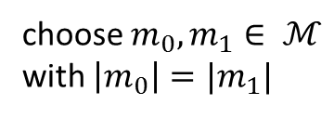



$$PrivK_{𝒜, Π}^{eav}\left(n,b\right)$$
Let $Π=\left(Gen, Enc, Dec\right)+ℳ$ be a private-key encryption.
Experiment $PrivK_{𝒜, Π}^{eav}\left(n,b\right)$
choose $m_{0}, m_{1}∈ ℳ$
with $\left|m_{0}\right|=|m_{1}|$
$$m_{0},m_{1}$$
$$k←Gen\left(1^{λ}\right)$$
$$Challenger$$
$$c←Enc(k,m_{b})$$
$$Adversary 𝒜$$
$$c$$
$$b^{′}$$
$$b^{′}={out}_{𝒜}(PrivK_{𝒜, Π}^{eav}\left(n,b\right))$$

Slide 13
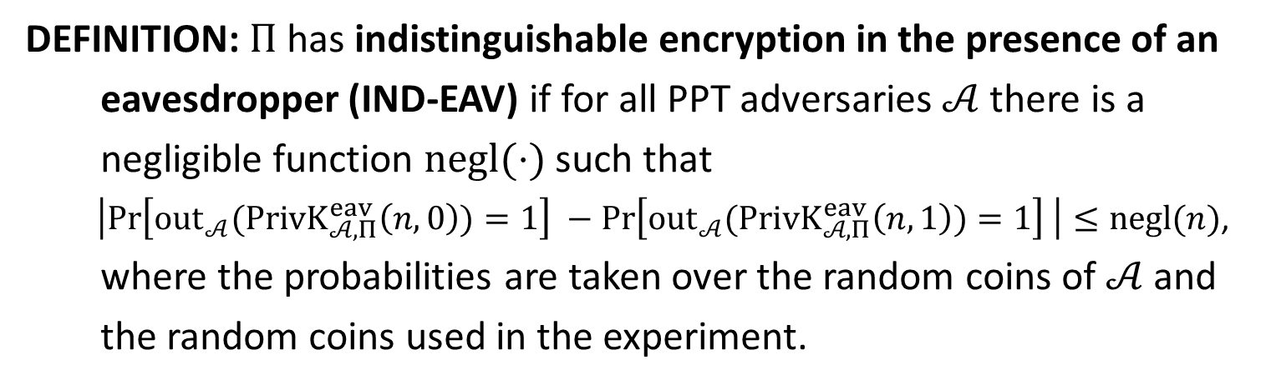
IND-EAV
DEFINITION: $Π$has indistinguishable encryption in the presence of an
eavesdropper (IND-EAV) if for all PPT adversaries $𝒜$ there is a
negligible function $negl(⋅)$ such that
$\left|\operatorname{Pr}\left[{out}_{𝒜}(PrivK_{𝒜, Π}^{eav}\left(n,0\right))=1\right] −\operatorname{Pr}\left[{out}_{𝒜}(PrivK_{𝒜, Π}^{eav}\left(n,1\right))=1\right] \right|≤negl(n)$,
where the probabilities are taken over the random coins of $𝒜$ and
the random coins used in the experiment.

Slide 15
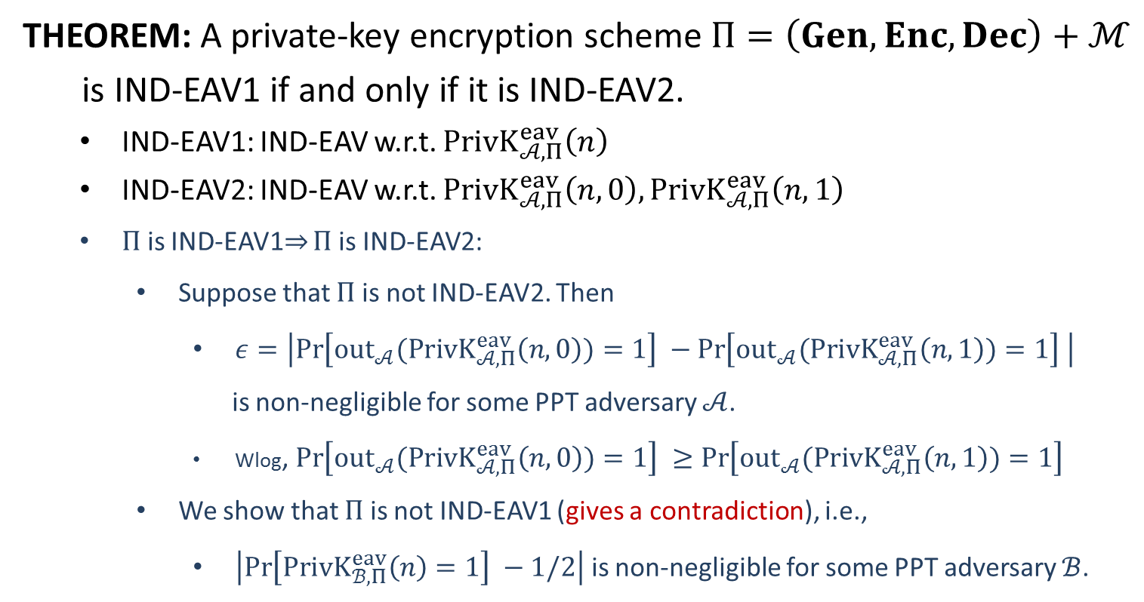
Equivalence
THEOREM: A private-key encryption scheme $Π=\left(Gen, Enc, Dec\right)+ℳ$
is IND-EAV1 if and only if it is IND-EAV2.
IND-EAV1: IND-EAV w.r.t. $PrivK_{𝒜, Π}^{eav}\left(n\right)$
IND-EAV2: IND-EAV w.r.t. $PrivK_{𝒜, Π}^{eav}\left(n,0\right),PrivK_{𝒜, Π}^{eav}\left(n,1\right)$
$Π$ is IND-EAV1$⇒$ $Π$ is IND-EAV2:
Suppose that $Π$ is not IND-EAV2. Then
$ε=\left|\operatorname{Pr}\left[{out}_{𝒜}(PrivK_{𝒜, Π}^{eav}\left(n,0\right))=1\right] −\operatorname{Pr}\left[{out}_{𝒜}(PrivK_{𝒜, Π}^{eav}\left(n,1\right))=1\right] \right|$
is non-negligible for some PPT adversary $𝒜$.
Wlog, $\operatorname{Pr}\left[{out}_{𝒜}(PrivK_{𝒜, Π}^{eav}\left(n,0\right))=1\right] ≥\operatorname{Pr}\left[{out}_{𝒜}(PrivK_{𝒜, Π}^{eav}\left(n,1\right))=1\right]$
We show that $Π$ is not IND-EAV1 (gives a contradiction), i.e.,
$\left|\operatorname{Pr}\left[PrivK_{ℬ, Π}^{eav}\left(n\right)=1\right] −1/2\right|$ is non-negligible for some PPT adversary $ℬ$.

Slide 16












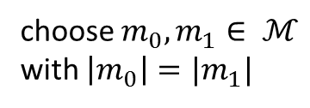


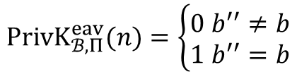

choose $m_{0}, m_{1}∈ ℳ$
with $\left|m_{0}\right|=|m_{1}|$
$$m_{0},m_{1}$$
$$m_{0},m_{1}$$
$$k←Gen\left(1^{n}\right)$$
$$b←\{0,1\}$$
$$c←Enc(k,m_{b})$$
$$c$$
$$c$$
$$b′$$
$$b^{′′}=\left\{\begin{aligned}0 b^{′}=1 \\ 1 b^{′}=0\end{aligned}\right.$$
$$b′′$$
$$PrivK_{ℬ, Π}^{eav}(n)=\left\{\begin{aligned}0 b^{′′}≠b \\ 1 b^{′′}=b\end{aligned}\right.$$
$$Challenger$$
$$𝓑$$
$$𝓐$$
$$PrivK_{𝓑 , Π}^{eav}\left(n\right)$$
$$PrivK_{𝒜, Π}^{eav}\left(n,b\right)$$

